Slide 1



DHARSHINI Portfolio
Author: Jack_sparrow
Created with Pi

Slide 2

CONTENTS
1. Introduction
2. Education
3. Certificates
4. Projects
5. Hobbies
6. Future Goal
7. Contact

Slide 3

01
Introduction

Slide 4
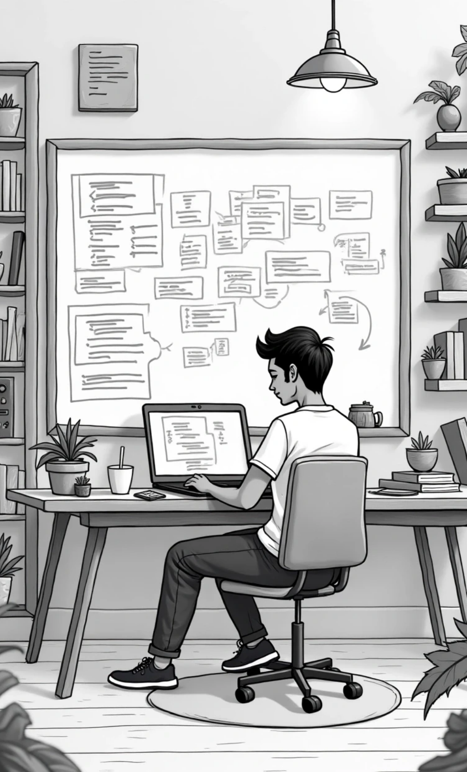

Hero Section
Hi, I'm DHARSHINI 👋
I am a B.Sc (CS) student from Anthiyur — passionate about technology & web development.
Button 1
See Projects
Button 2
Contact Me
About Me
I'm Dharshini, a 2nd-year B.Sc Computer Science student at Government Arts & Science College, Anthiyur (Bharathiar University). I love creative coding and practical learning.

Slide 5

02
Education

Slide 6

My Education
B.Sc Computer Science — Govt Arts & Science College, Anthiyur
10th -Government sch 56.6% 12th-Government sch 62.9%

Slide 7

03
Certificates

Slide 8
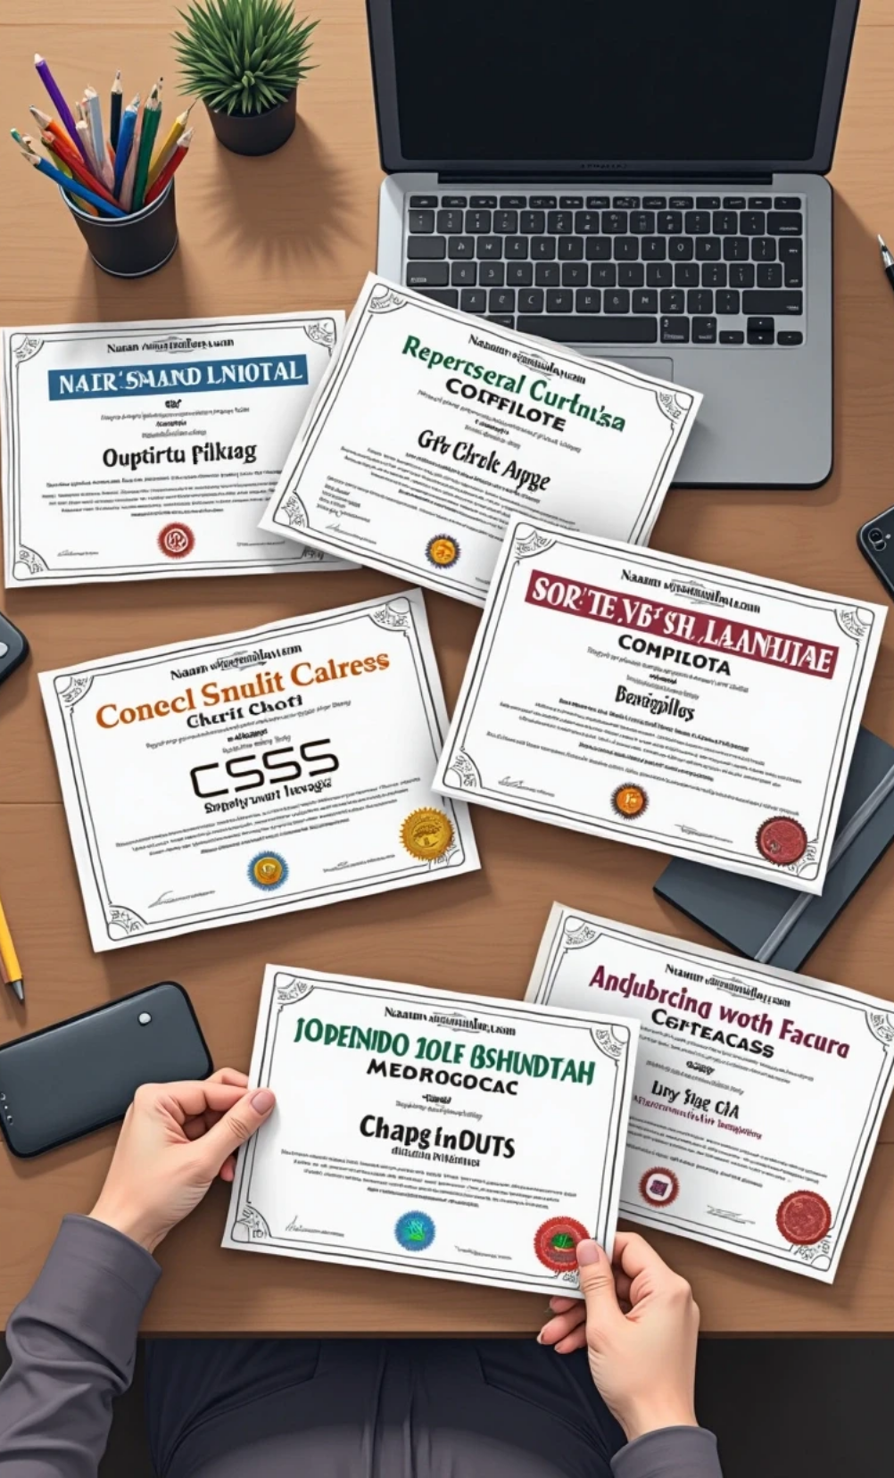

My Certificates
Naan Mudhalvan — HTML
Naan Mudhalvan — CSS
Naan Mudhalvan — JavaScript
Web Development Basics

Slide 9

04
Projects

Slide 10
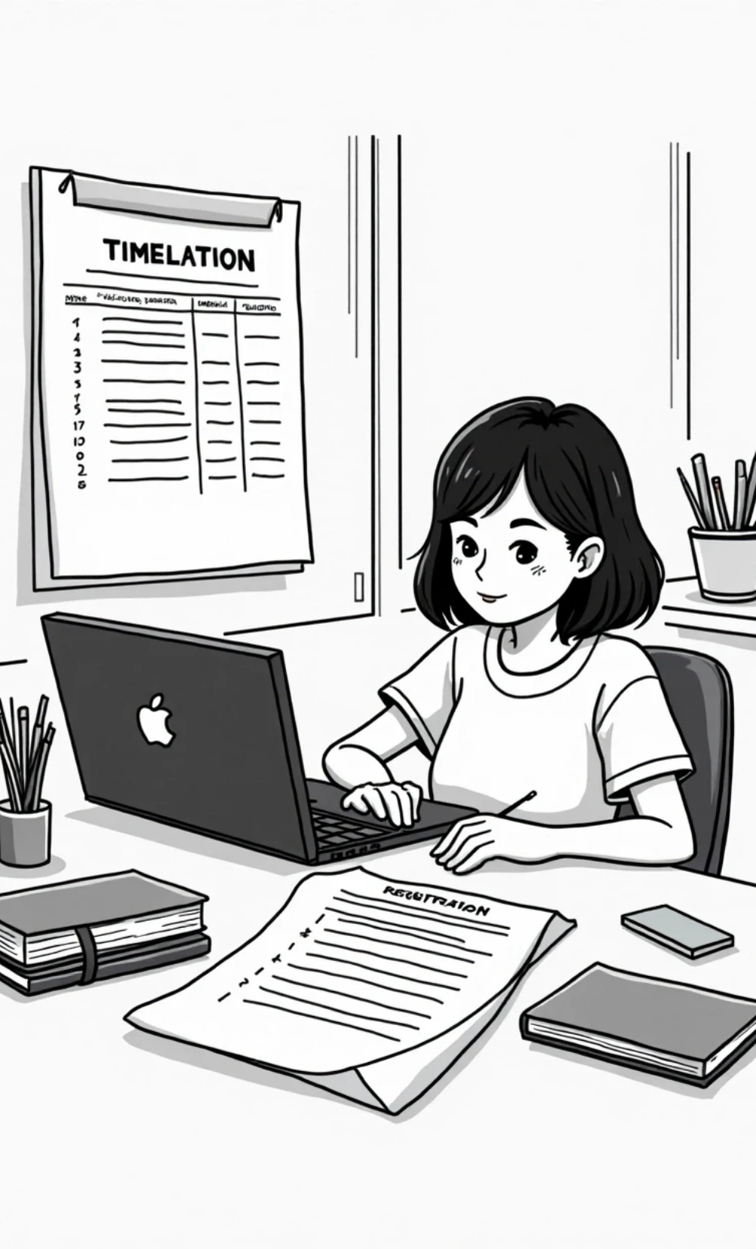
My Projects
Registration Form
B.Sc CS Timetable

Slide 11

05
Hobbies

Slide 12
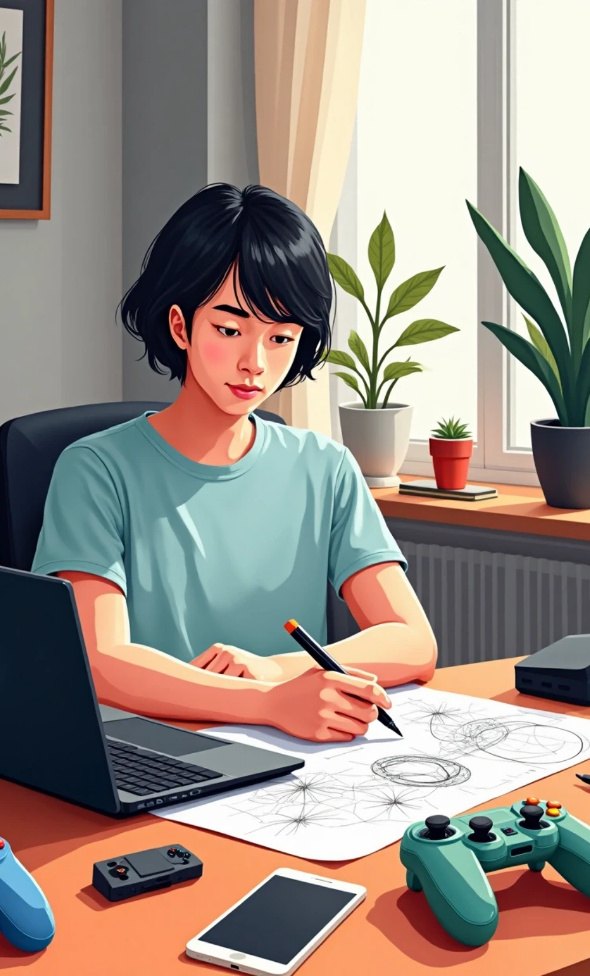

My Hobbies
Drawing diagrams
Playing games
Learning through practice
Reading Books

Slide 13

06
Future Goal

Slide 14
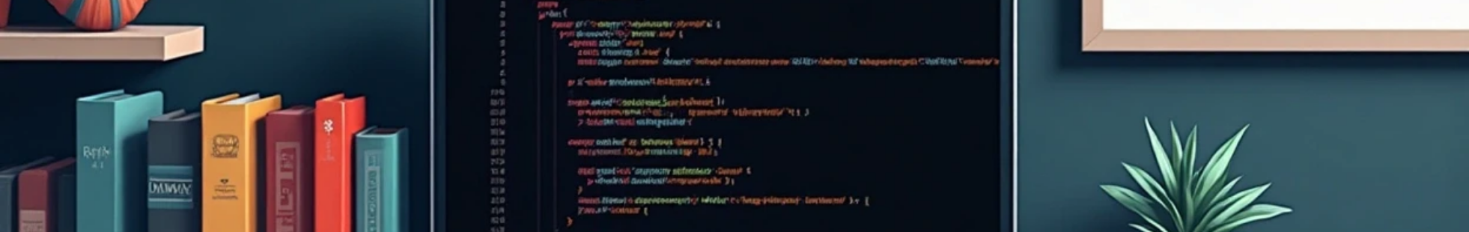
My Future Goal
I want to learn Java and become a professional game & app developer 🚀.

Slide 15

07
Contact

Slide 16
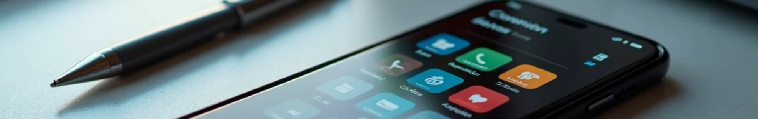

My Contact Information
📞 Phone
📧 Email
📸 Instagram
9385923357
dharshini6985@gmail.com
dharshini_2006
© 2025 Dharshini Portfolio

Slide 17
Thank You

